Slide 1
Sensing
Instructor: Deepak Gangadharan
(Mostly using content from NPTEL lecture on Introduction to Internet of Things)

Slide 2
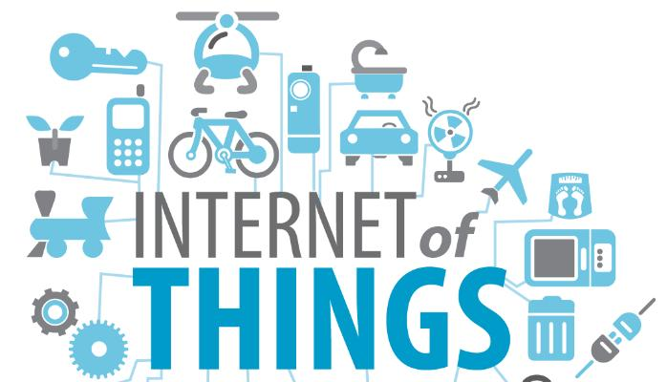
Recap
History of IoT
What is IoT?
IoT Applications
M2M vs IoT
Importance of IoT
Challenges/Impediments
Case Study
Source: https://www.groundreport.com/

Slide 3
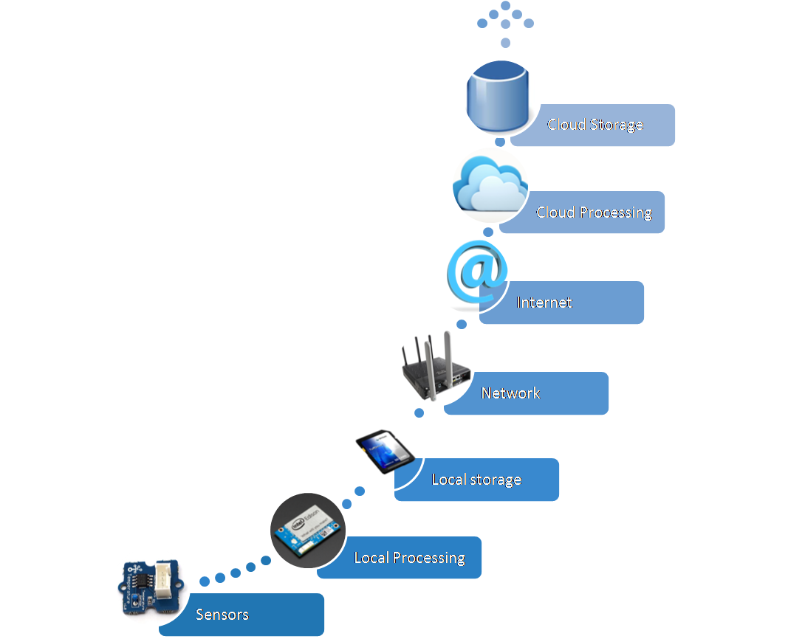
Upstream Information Flow in IoT
The initial information flow did not encompass the local storage and the local processing – Purely cloud based processing
Currently edge computing is a concept that is gaining prominence whereby there is availability of some local processing and storage
Source: http://ocw.cs.pub.ro/courses/_media/iot2015/courses/picture11.png?w=450&tok=584430

Slide 4
What is a Sensor?
A sensor detects (senses) changes in the ambient conditions or in the state of another device or a system, and forwards or processes this information in a certain manner [1].
“A device which detects or measures a physical property and records, indicates, or otherwise responds to it” [2]. – Oxford dictionary
References 1. http://www.businessdictionary.com/definition/sensor.html 2. https://en.oxforddictionaries.com/definition/sensor

Slide 5
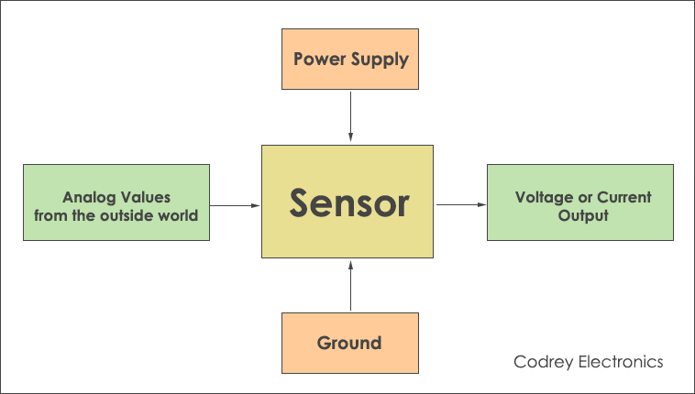
Block Diagram
Source: https://www.codrey.com/electronics/different-types-of-sensors/

Slide 6
Sensors
Perform some input function by sensing or feeling the physical changes in characteristics of a system in response to some stimuli
Example: In a temperature sensor, heat is converted to electrical signals

Slide 7
Transducers
Convert one form of energy into another
Example: In a sound system, a microphone converts sound waves into electrical signals, which are then amplified by an amplifier and a loudspeaker converts the electrical signals back into sound waves
It is a collective term that includes both sensors and actuators

Slide 8
Sensor Features
Sensitive only to the measured property (temperature sensor only senses the ambient temperature)
Insensitive to any other property encountered in the system
Does not influence the measured property

Slide 9
Sensor Resolution
Resolution: The smallest change the sensor can detect in the quantity that it is measuring
The more the resolution of a sensor, the more accurate is its precision
Accuracy of a sensor is not dependent on the resolution

Slide 10
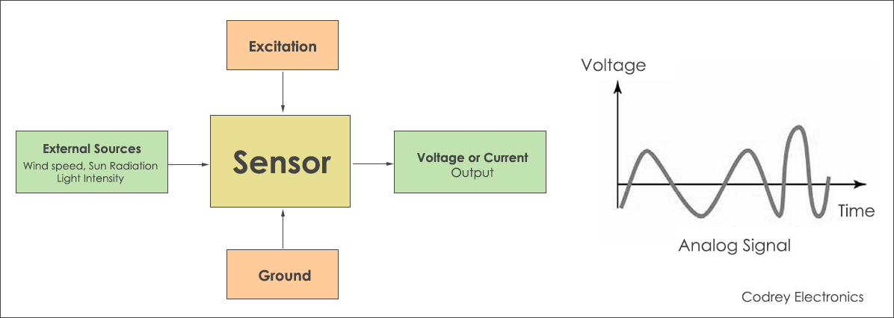
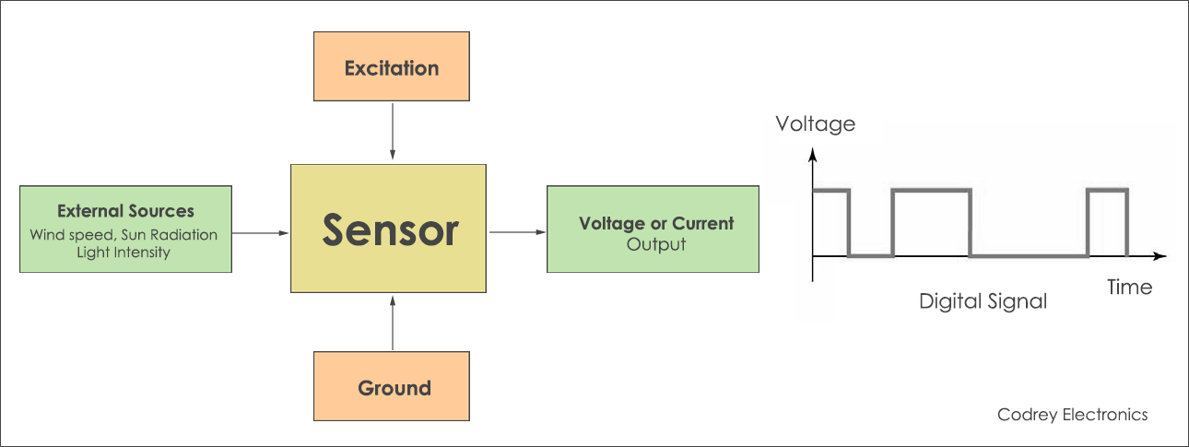
Sensor Classes (Based on Output)
Analog Sensor
Digital Sensor

Slide 11
Sensor Classes (Based on Data Type)
Scalar Sensor: Measure scalar values (Temperature sensor) Physical quantities: temperature, color, pressure, etc
Vector Sensor: Measures the value and the orientation (Camera sensor) Physical quantities: Sound, image, velocity, acceleration

